Slide 1
Parent/Educator Collaborative
Community Forum
11/30/23

Slide 2
Agenda
Context
Newton Educators’ Priorities
How is the process going?
Financial Aspects of a Fair Contract
Supporting NPS Educators
Discussion

Slide 3
What is the Parent/Educator Collaborative?
The PEC formed in the summer of 2020 out of concern of lack of educator input into “Return to Learn” plans, as well as a spike in anti-teacher rhetoric among both community members and NPS administration.
Over the past three years, we’ve worked to create communication channels between building-based staff and city leaders.
The PEC is a partnership between the Newton community and the Newton Teachers Association.

Slide 4
Notes:
Talk about the vibe in the building

Slide 5
From Anna Nolin’s Entry Plan: Staffing and Human Resources Sections
Pandemic Burnout: Staff members are experiencing burnout due to pandemic-related challenges, contentious contract negotiations, constant challenge and demand (coupled with increasing aggression) from families, and community and internal trust issues. Years of budget cuts have also degraded morale and made staff skeptical of the district and its operations. Addressing these issues is critical for creating a positive work environment.
Recruitment and Morale: The district's ability to attract new, younger staff is hindered by perceived district instability due to budget concerns. Morale among less-experienced staff is low, primarily due to fears of possible cuts and concerns about financial stability in the profession.
In the summary of her presentation, Dr. Nolin listed
“Settle the NTA Contract” as her top priority.

Slide 6
Contract Settlement Delay: Valerio, Dominello, and Hillman LLC
The firm Valerio, Dominello, and Hillman LLC was hired in June 2022 by the Newton School Committee to begin contract negotiations with the Newton Teachers Association.
This firm has advised several communities with their educator contract negotiations including Brookline, Andover, Sharon, and Ashland.
A number of these contract negotiations lasted more than a year–Brookline’s negotiations lasted over two full years–Newton is in its 15th month of negotiations.
Protracted negotiations = increasing legal fees paid for from the school budget.
Brookline educators described the firm as one that breeds “ill will and contempt” along with a lack of respect for the educators, resulting in low morale and rising tensions.
Other tactics being used include punitive proposals, seeking significant concessions, and demanding mediation early in the process.
Notes:
Hiring outside counsel by school committees for negotiations with educator unions is common practice, including Newton’s school committee. Has been going on since I’ve been negotiating as a union officer over the past 20 years.

Slide 7
Informing the Community- Pushing for Transparency
Who made the decision to hire Valerio, Dominello and Hillman LLC?
Was everyone on the School Committee aware of their history of long, contentious negotiations? A firm that multiple members of Brookline’s negotiating team described as one that breeds “ill will and contempt.”
Who made the decision to pay the law firm out of the NPS budget?
Why wasn’t this expense discussed in the public NPS budget deliberations last spring and the spring before?
How much has been spent so far on Valeria, Dominello and Hillman LLC?

Slide 8
11/28 Finance Committee Mtg
Wide acknowledgement among ALL speaking at the meeting that the schools need immediate and significant funding, as described by Dr. Nolin.
Dr. Nolin attempted to organize groundbreaking meeting between School Committee, City Council and herself.
Conversation stayed focused on the $26M, but there is no clear plan that these funds would be directed to NPS.
Spending down funds while it remains as “free cash” was rejected as unsound financial practice.
The Council put the Mayor’s stabilization fund on HOLD.
Everyone agrees money is needed for Superintendent’s Entry Plan
WHAT NEXT?

Slide 9
Newton Educators’ Priorities:
Close Alignment with Superintendent’s Entry Plan

Slide 10
Priorities of Newton Educators
Student Mental Health
A portion of the federal funds were earmarked for school districts to add mental health supports.
The NTA is proposing that every school in Newton have a full-time social worker to help support students and families.
Address the understaffing of Newton Schools
Last year, NPS had over 100 unfilled ESP/teaching assistant positions (Unit C).
The NTA is proposing NPS raise the starting salary for Unit C members to recruit and retain teaching assistants. This proposal is in line with statewide trends towards higher compensation and acknowledgement for teaching assistants/paraprofessionals.
Understaffing due to budget cuts over several years
Improved Daily Instruction and Coverage
NPS wants to change “time and learning” agreement, so that teachers might be asked to sub during what should be their prep time.
NTA is proposing the district hire more substitutes in buildings, and pay teachers who volunteer to cover classes should a substitute not be available.

Slide 11
How is the process going?

Slide 12
How is the process going?
August 31: Last year’s contract expired. Newton educators returned to work with no contract.
September 16: Mediation sessions with state representative began. Newton educators and School Committee members negotiate in separate rooms, with a mediator as a go-between.

Slide 13
Financial Aspects of a Fair Contract

Slide 14
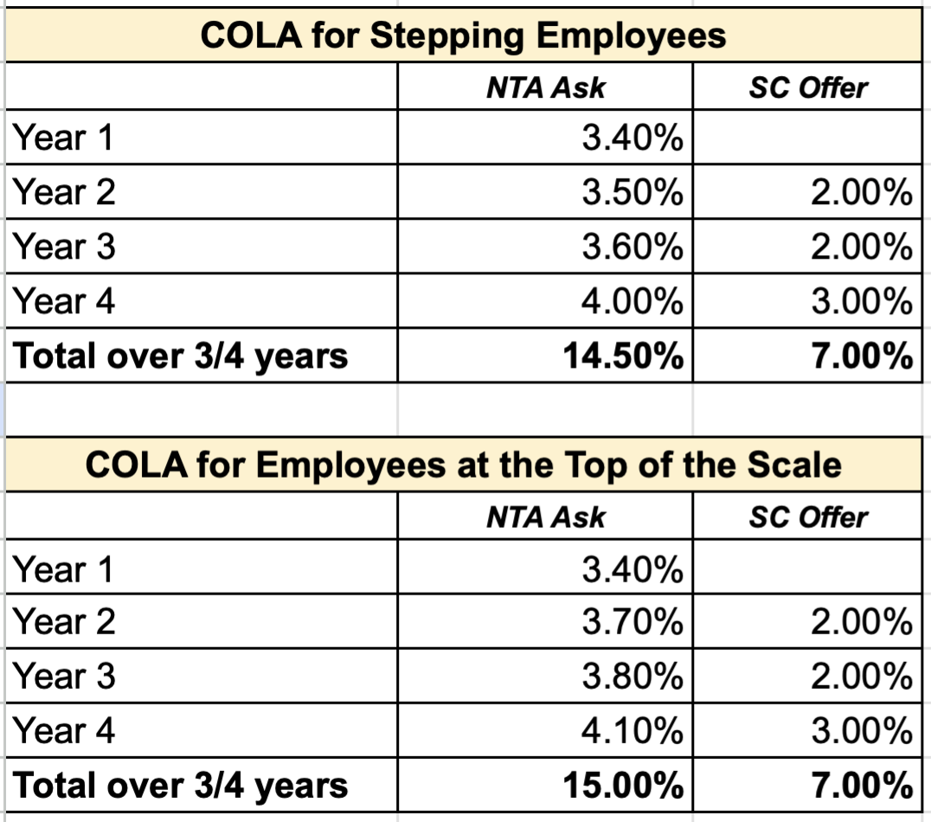
Costs Associated with NTA Contract
Notes:
Substitute new numbers + data about health insurance increase

Slide 15
Costs Associated with NTA Contract
Changes in health insurance costs for employees:
increase employee premium contribution rate for PPO plan;
increase deductible from $250/$500 to $400/$800 per year;
increase "retail" (minute clinic) and urgent care co-pays from $5 and $10 respectively to $20;
Newton is trying to shift more of the cost
Of health insurance onto educators.

Slide 16
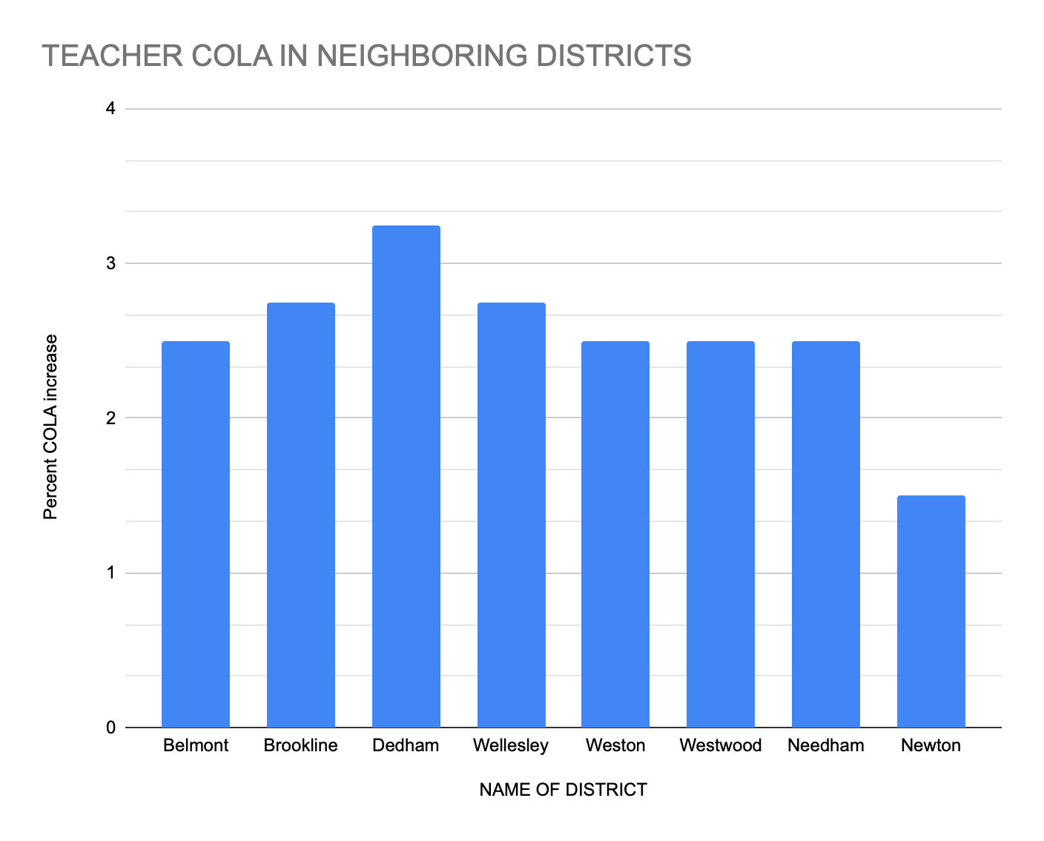
Costs Associated with NTA Contract

Slide 17
Costs Associated with NTA Contract
Mayor’s Spending Proposals
In mid-August, Mayor Fuller put forth a proposal called the “Booster Stabilization Fund”. In this proposal, $26 million would be put in a fund for the next eight years. Starting next year, a small amount of that money (0.18 of the school budget) would be given to NPS. In the following years, larger amounts of money would go to NPS. No money would go to NPS this school year. City Council has been debating this plan for two months. On October 16, the plan was rejected by the City Council.
On November 28, the City Council Finance Committee began debate on a new proposal: the “Debt Service Stabilization Fund”. This proposal is remarkably similar to the “Booster Stabilization Fund”, in that it gives no money to NPS this school year. The Finance Committee voted to “hold” on this proposal. Most felt it did not meet the goal of providing the funding that is needed by NPS.

Slide 18
Supporting NPS Educators

Slide 19
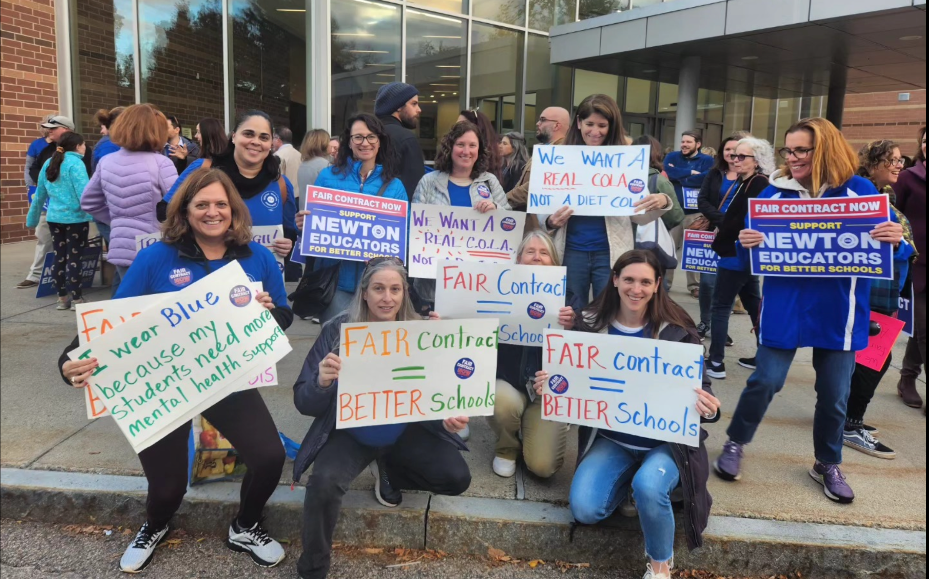
October 23 Rally
1200 people (Newton educators, community members, and supporters from other nearby Teachers’ Unions) attended the rally.
At the School Committee meeting, the Newton educators handed over a petition that was signed by 1900 NTA members demanding a Fair Contract

Slide 20
How can YOU help?
Visit the Parent/Educator Collaborative Website!
Contact the Mayor and the School Committee. Reinforce for them the impact that underfunding has had on NPS over the last few years. We need to invest in our schools right now.
Contact your City Councilors. Ask them to vote “no” on any spending proposal that doesn’t include funding for NPS for this year.
Make public comment at 12/4 School Committee meeting
Postcards (we can drop them off at your house)
Email campaign: Click here to send a form letter to the Mayor
Send a message to five friends
Put “Fair Contract” signs in your office windows.
Click here to request a lawn sign.
Click here to get more information about these actions

Slide 21
How can YOU help?
Sample email:
Dear Friends,
I just attended a Community Forum hosted by the Parent/Educator Collaborative (PEC). Their presentation provided important background information that I found useful in understanding how it is that the city has reached a standstill in the contract negotiations with Newton Educators.
I know how much you value your children’s teachers and the work that they do. Please take a look at these slides from the PEC. I hope you will consider taking one of their suggested actions.
Sincerely,

Slide 22
Discussion

